Slide 1

Welcome to Year 4

Slide 2
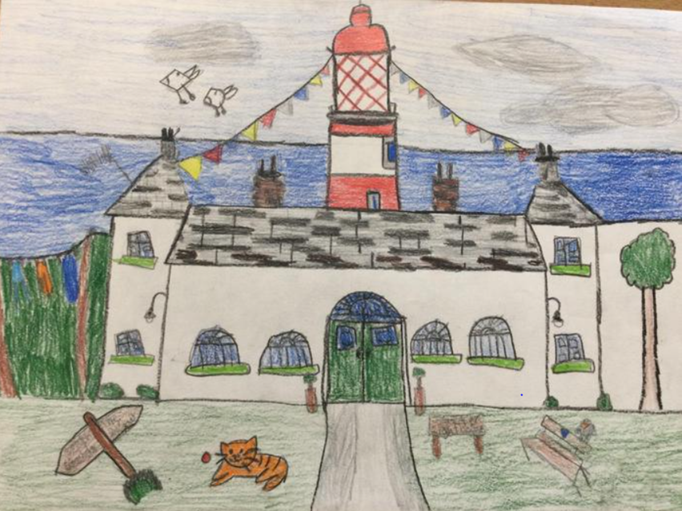

Aims of the Meeting:
To provide an overview of life in Year 4 at Sea View Primary.

Slide 3
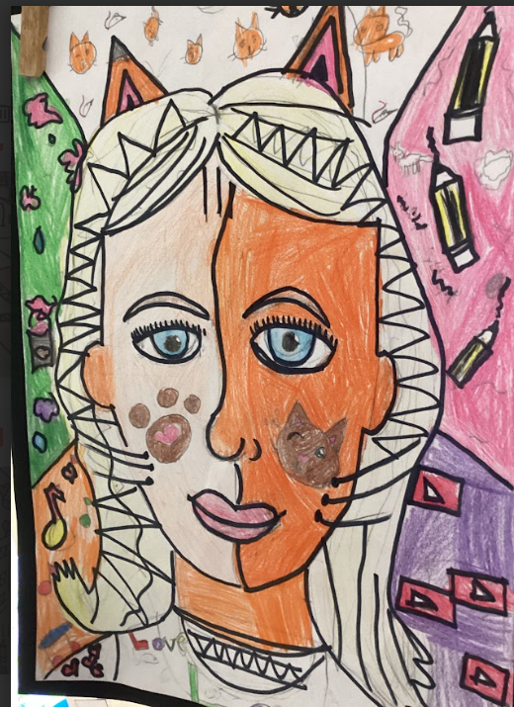
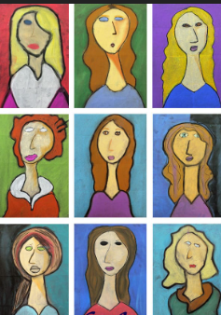
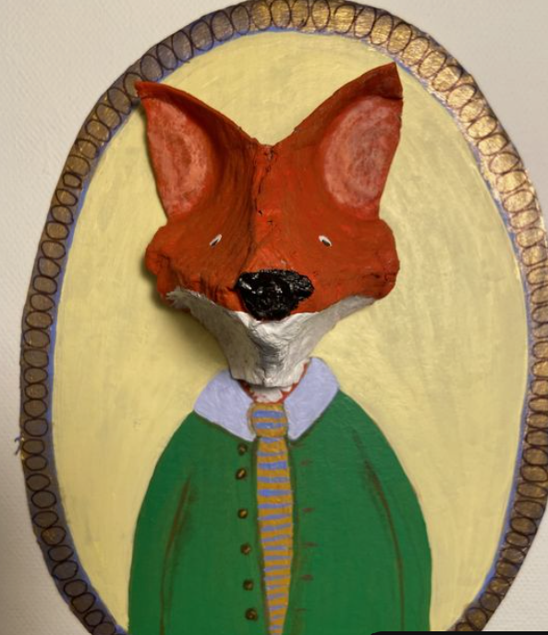
Year 4
The Team
Golden Rules- Expectations
We’re in it together!
The Curriculum
Assessment
Exciting Opportunities in Year 4
Communication
Questions

Slide 4
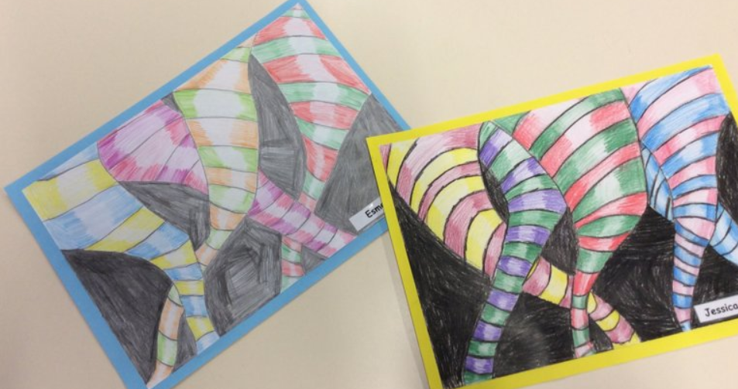
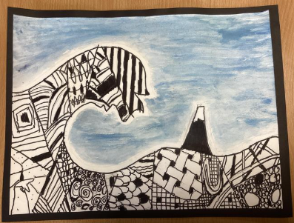
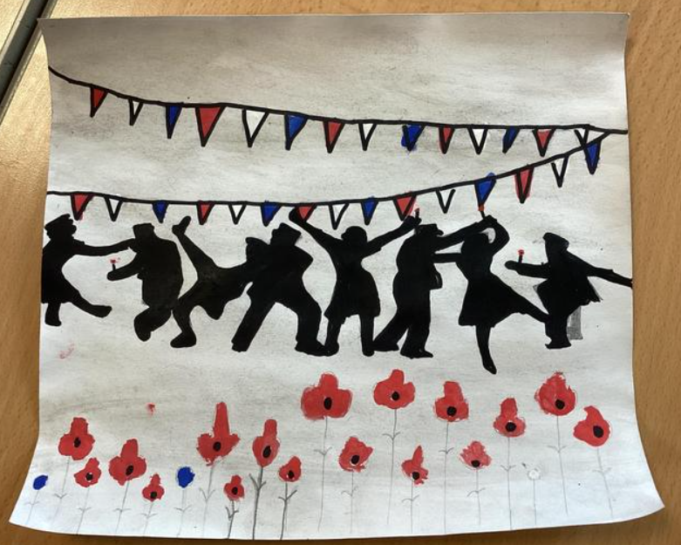
Meet The Year Team:
Class Teachers
Mrs H Mosley
Miss Darling
Classroom support
Mrs H Back
Mrs Smirnov
Miss B Fairley

Slide 5

Golden Rules:

Slide 6
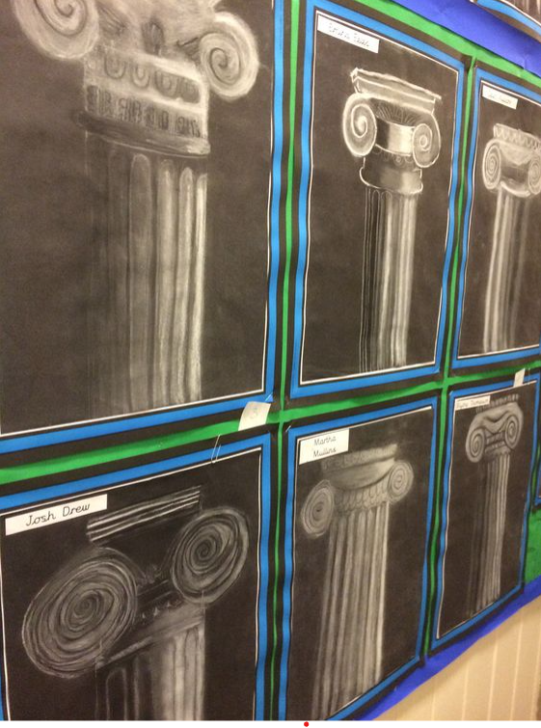
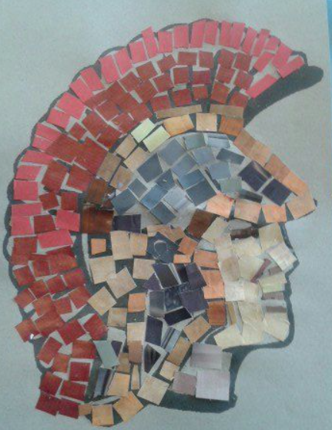
We’re in it together!
Pupils – to give 100% effort in all you do.
Staff – will do all we can for ALL children to reach their potential.
Parents - to continue to support and encourage your child.

Slide 7
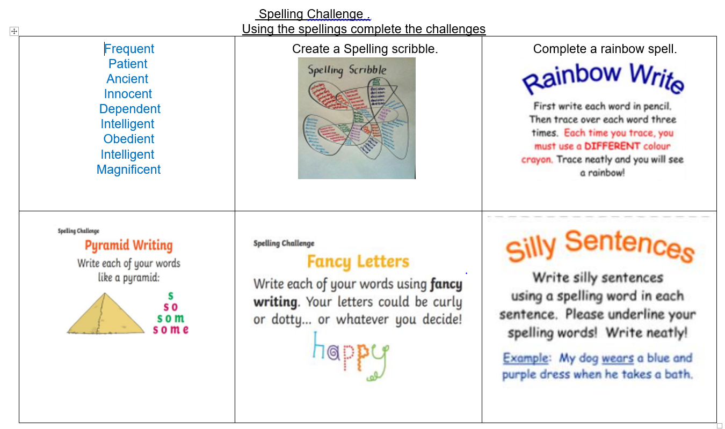
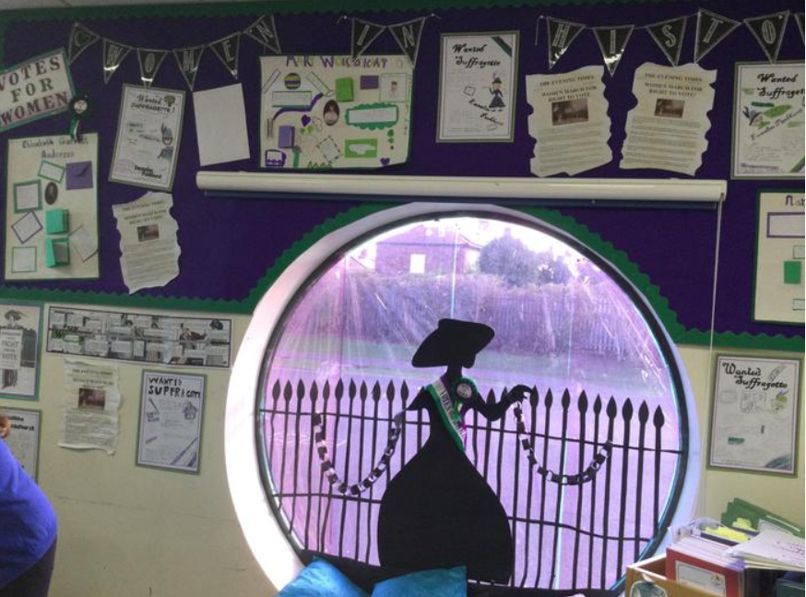
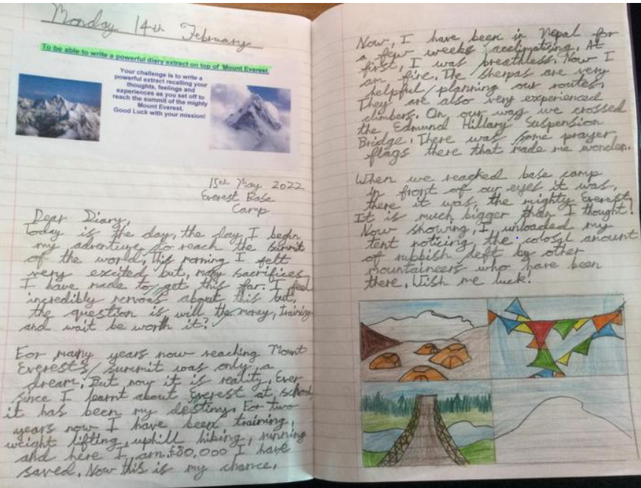
Homework.
Homework will be given every Friday.
Spellings – given on a Friday and tested the following Friday.
TTRockstars – Garage sessions
Reading

Slide 8
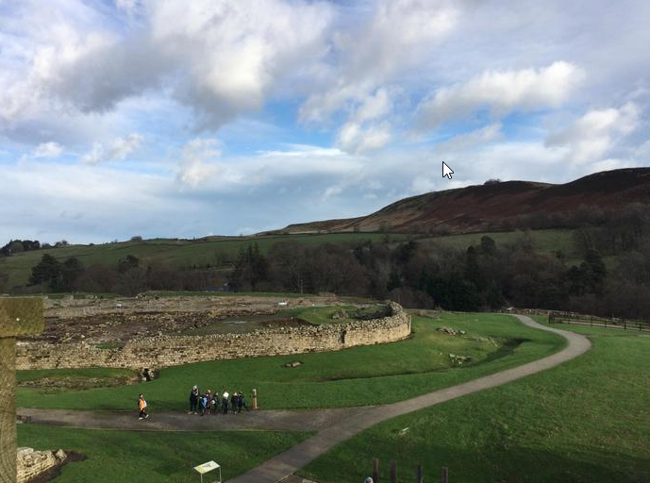
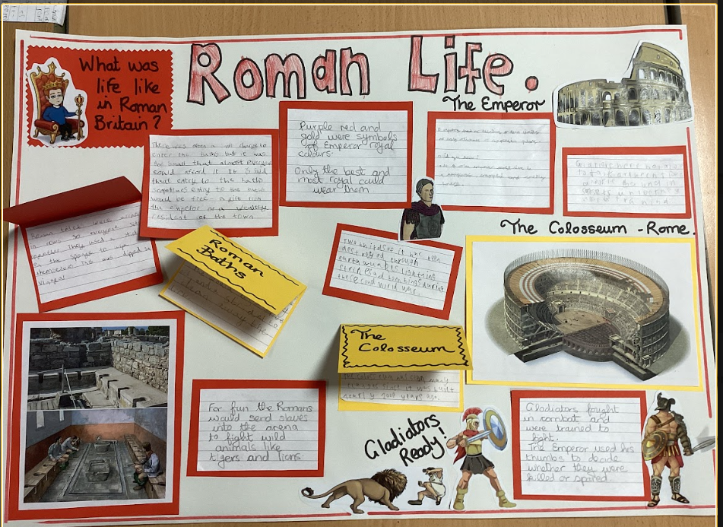
The Curriculum.
Autumn Term:
Ancient Rome
States of Matter & Electricity
The Nowhere Emporium
Spring Term:
Natural Disasters
Digestive System & Sound
Erupting volcanoes
Summer Term:
Ancient Greece
Living Things
The Impressionists
P.E.
*Every Tuesday
*P.E. kit – white t-shirt, blue or black shorts
* No jewellery

Slide 9
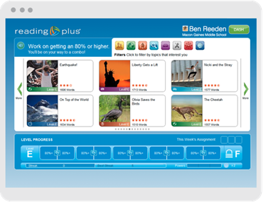
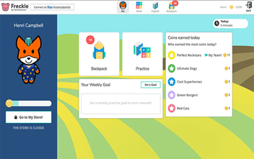
Assessment Year 4
Times tables check
Star Reading Assessment
Reading Plus
Freckle
Assessments Termly.

Slide 10
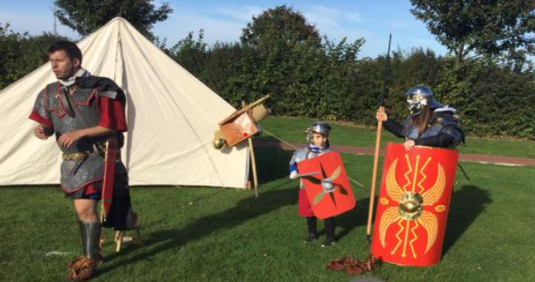
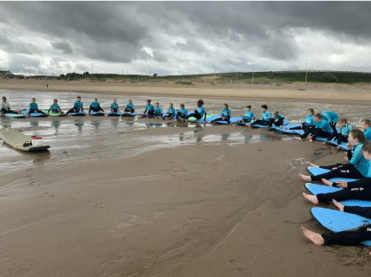

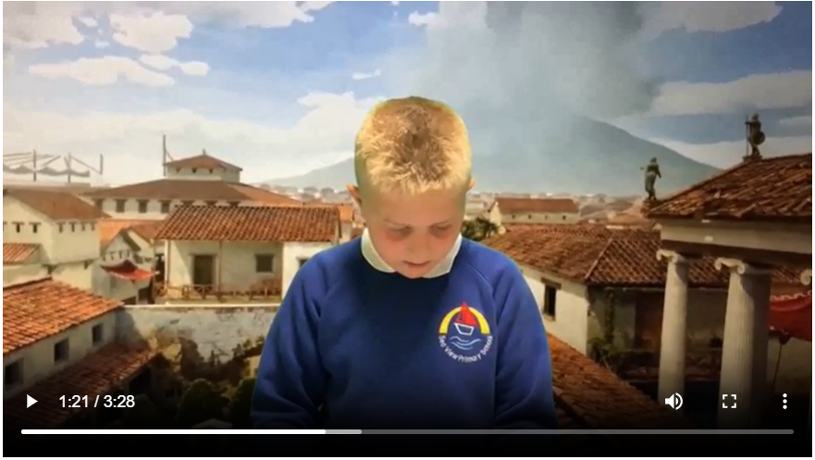
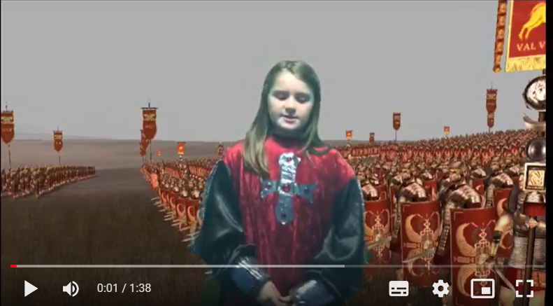
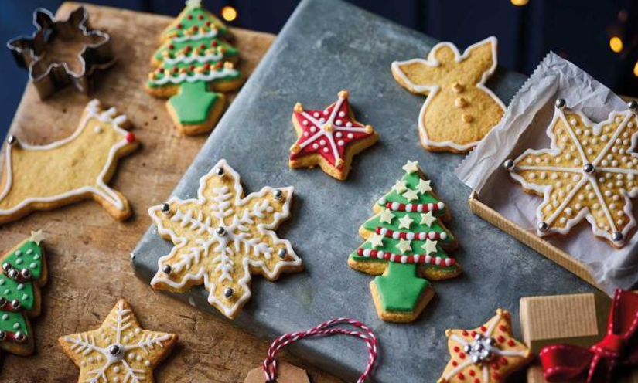
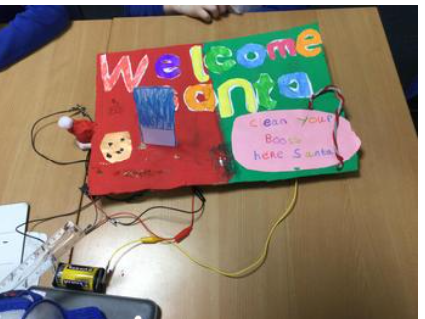
Exciting Opportunities in Year 4

Slide 11
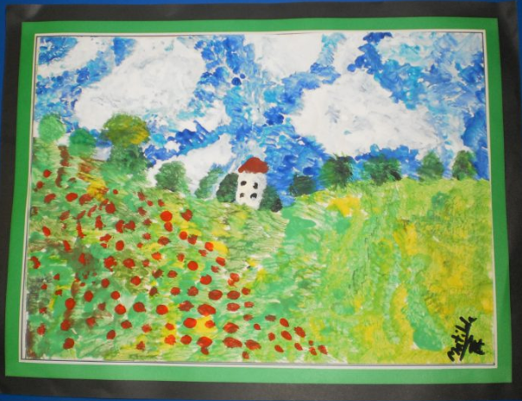
Communication:
The Website
Class Dojo
Parents Evenings
Reports

Slide 12
Thank You for coming…
Any questions?

